Slide 1

Supermarket data analysis
Chen Alfasi
Link:

Slide 2
AGENDA
Introduction​
Data set
​Methodology
Observations
Insights & Recommendations

Slide 3
Introduction
In this project, I will analyze data from a supermarket chain in the United States. The data includes information on each sale during the first quarter of 2019. The analysis, the queries, and the visualization will be performed by SQL and Power Bi in order to obtain business insights.

Slide 4
Data set
Our data set includes the following data:
Every sale has an Invoice ID, Branch, City, Customer type, Gender, Product line, Unit price, Quantity, Total, Date, Time, Payment type, Cogs, Gross income, and Rating.

Slide 5
Methodology
Our analysis and examination focused on the following parameters:
1. Months. 2. Supermarket’s Branches. 3. Product type.
4. Gender. I performed the analysis in order to understand which products are the most profitable and have high ratings from the customers in order to continue selling these products, and at the same time understand which products should be taken off the shelves.
In addition, I tried to determine which branch is the most profitable and has a high rating, while in the branches with a low rating we will invest effort in order to increase profitability and customer satisfaction.
Beyond that, I also analyzed the data by month to check if there is any trend and if customer satisfaction has increased or decreased and if the supermarket's profits have increased or decreased.

Slide 6
Observations
Analysis by Months
Analysis by Branches
Analysis by Product Type
Summary

Slide 7
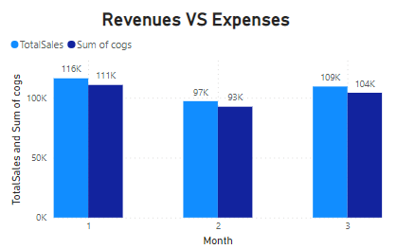
Analysis by Months

Slide 8
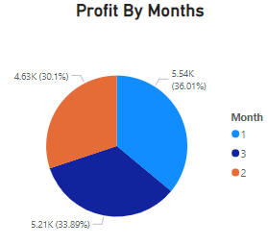
Analysis by Months

Slide 9
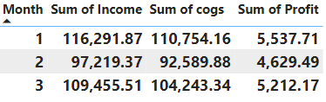
Analysis by Months

Slide 10
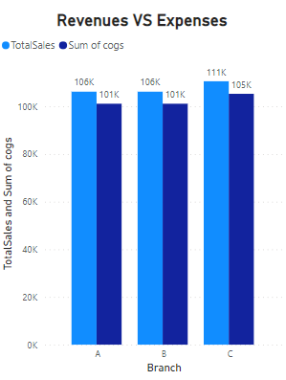
Analysis by Branches

Slide 11
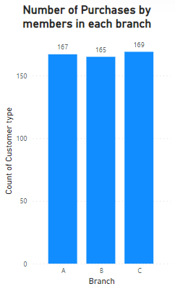
Analysis by Branches

Slide 12
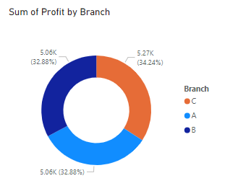
Analysis by Branches

Slide 13
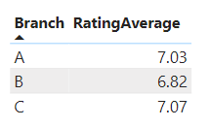
Analysis by Branches
In this Table, we can see the Rating average of each branch. As we can see branch C is the successful branch– there is a direct proportion between the number of purchases and the Rating average.

Slide 14
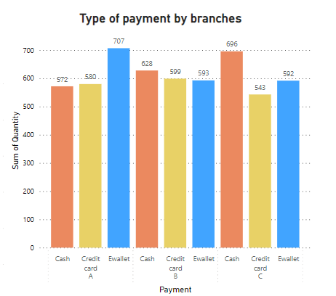
Analysis by Branches
In this Cluster column chart, we can see the number of payment type by each branch. As we can see in branch A The most purchases were made by Ewallet while in the other branches, most purchases were made by cash.

Slide 15
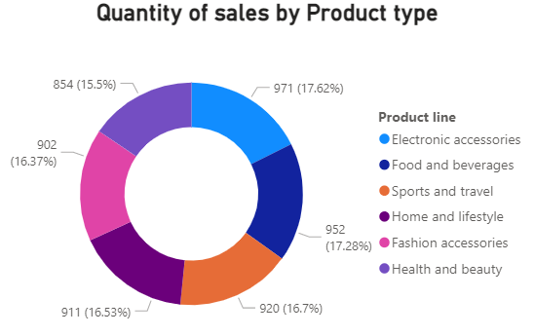
Analysis by Product Type
In this Donut chart, we can see the number of sales of each product type. As we can see the most popular product is Electronic accessories, while the least popular product is Health and beauty.

Slide 16
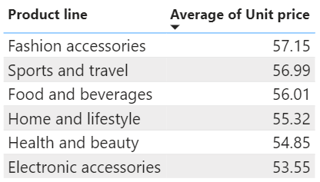
Analysis by Product Type
In this Table, we can see the average unit price by Product type. As we can see the cheapest average product type is Electronic Accessories and this is the reason why his quantity of sales is the highest, while the most expensive average product type is Fashion Accessories and this is the reason why his quantity of sales is almost the lowest.

Slide 17
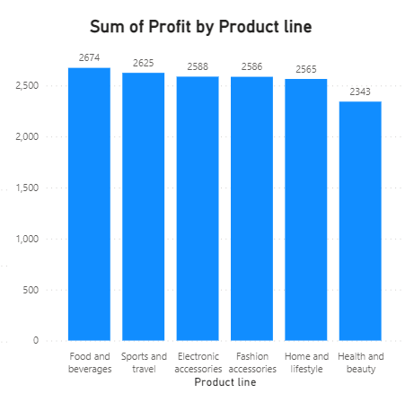
Analysis by Product Type
In this Clustered column chart, we can see the profit by Product type. As we can see the least profitable product type is Health and beauty and there is a direct proportion between it to the number of sales, and this is despite his lower average price. In addition, Food and Beverages are the most profitable.

Slide 18
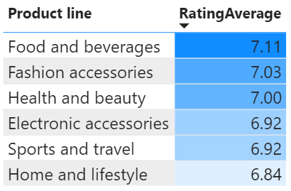
Analysis by Product Type
In this Table, we can see the Rating average by Product type. As we can see the highest Rating average is Food and Beverages, there is a direct proportion between it and profitable.

Slide 19
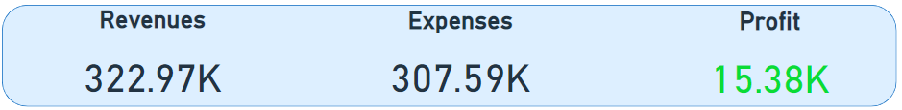
SUMMARY
Here we can see the Revenues, Expenses, and Profit in the first quarter of 2019 in the supermarket. In the bottom line – the first quarter is profitable.

Slide 20
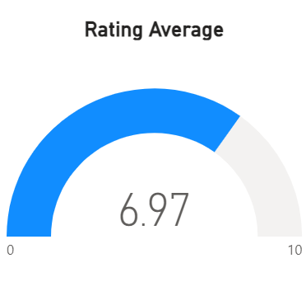
SUMMARY
This is the Rating average of the Supermarket chain in the first quarter of 2019.

Slide 21
Insights & Recommendations

Slide 22
In February, the income and profitability in the supermarket chain are the lowest because February is the shortest month.
The profitability and the number of sales in branch C are the highest, and so is the rating in branch C - which indicates on the employees’ attitude in the branch, the quality of the products, and the short wait at the cash desk. Therefore branches A and B can learn from branch C in terms of conduct. I recommend a tour of all the employees from branches A and B in branch C.
The number of sales of Electronic Accessories is the highest, in addition, the average price per unit of Electronic Accessories is the lowest. That is why the number of electronic products must be increased since their high profitability.

Slide 23
The food products are the most profitable and have the highest ratings. In other words, customers are satisfied with them and the profit from them is the best. Therefore, I recommend increasing the number of products of this type in order to increase profits and maintain high customer satisfaction.
Health and beauty products sell the least and bring the least profit. Recommend considering a change in these products and checking if the change brought positive results. If not, recommend stopping selling these products to save inventory costs on products that are not profitable enough.
In branch A, most customers prefer to pay with Ewallet, in contrast to branches B and C, where customers prefer to pay with cash. I Recommend opening a self-service cash desk in branch A that allows payment via Ewallet and will lead to reducing queues at the cash desk.

Slide 24
THANK YOU
Chen Alfasi
Chenalfasi7@gmail.com

